Slide 1
CSE 2202 Design and Analysis of Algorithms – I Lecture 7 Euler Path, Minimum Spanning Tree (Kruskal and Prims)

Slide 2
EULER GRAPH AND CIRCUITS

Slide 3
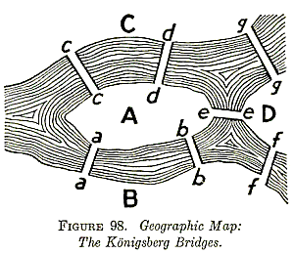
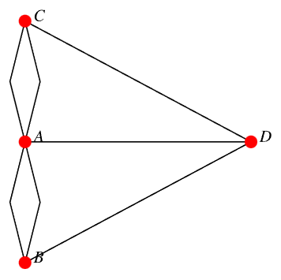
The Königsberg bridge problem
Notes:
The Königsberg bridge problem is a historical problem that inspired Euler to develop these concepts of paths and circuits in graphs.
The city of Königsberg (now Kaliningrad, Russia) had the Pregel River running through it, creating four distinct land areas connected by seven bridges. The problem was simple: Is it possible to walk through the city and cross each of the seven bridges exactly once?
Euler abstracted this problem by representing the land areas as vertices and the bridges as edges of a graph.

Slide 4
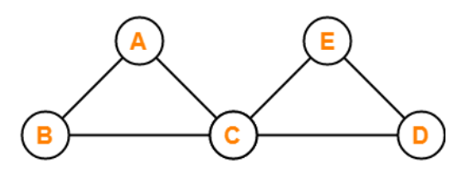
Walk and Trail
A walk is defined as a finite length alternating sequence of vertices and edges.
vertices and edges can repeat in a walk, but in trail, only vertices repetition is allowed – not edge repetition.

Slide 5
Walk
A walk in a graph is an alternating sequence of vertices and edges, starting and ending with a vertex, where:
Vertices represent points or nodes.
Edges represent connections or links between vertices.
The length of a walk is the number of edges it traverses.
In a walk, both vertices and edges can repeat any number of times.
Open or Closed:
An open walk starts and ends at different vertices.
A closed walk starts and ends at the same vertex.

Slide 6
Types of Walks
Depending on the characteristics and restrictions, walks can be further categorized:
a. Trail: A trail is a walk in which no edge is repeated. However, vertices can repeat. It can be open or closed.
b. Path: A path is a walk where no vertex or edge is repeated (unless it's closed, where the first and last vertices may be the same).
c. Circuit: A circuit is a closed trail, meaning it starts and ends at the same vertex but does not repeat any edge.
d. Cycle : A cycle is a closed path that starts and ends at the same vertex but doesn't repeat any other vertices or edges.

Slide 7
Euler Path
Euler path is also known as Euler Trail or Euler Walk.
If there exists a Trail in the connected graph that contains all the edges of the graph, then that trail is called as an Euler trail.
Trail is an open walk in which no edge is repeated.
Vertex can be repeated.
If there exists a walk in the connected graph that visits every edge of the graph exactly once with or without repeating the vertices, then such a walk is called as an Euler walk.
Euler Path and Euler Circuit: These are special types of paths and circuits that cover every edge exactly once:
Euler Path: An open walk that covers every edge once.
Euler Circuit: A closed walk that covers every edge once.

Slide 8
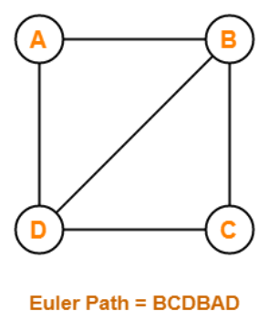
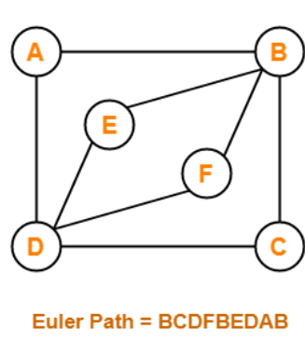
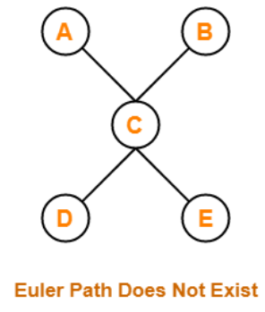
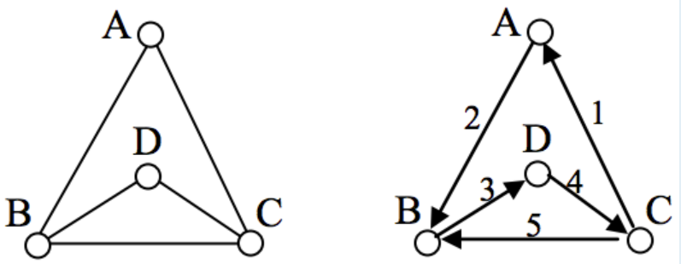
Euler Path Examples

Slide 9
Euler Circuit
If there exists a walk in the connected graph
that starts and ends at the same vertex and
visits every edge of the graph exactly once with or without repeating the vertices,
then such a walk is called as an Euler circuit.
An Euler trail that starts and ends at the same vertex is called as an Euler circuit.
A closed Euler trail is called as an Euler circuit.

Slide 10
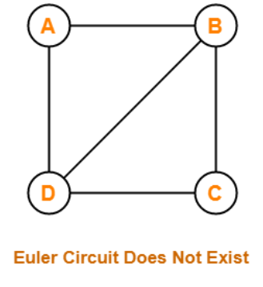
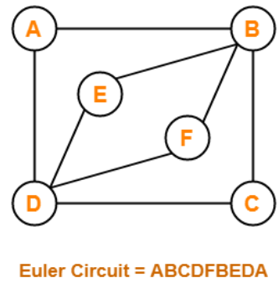
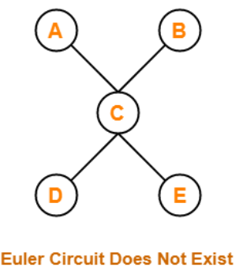
Euler Circuit Examples
A graph will contain an Euler circuit if and only if all its vertices are of even degree.

Slide 11
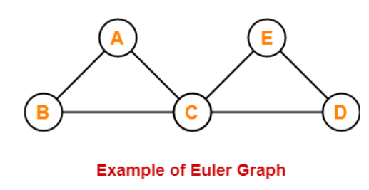
Euler Graph
Any connected graph is called as an Euler Graph if and only if all its vertices are of even degree.
An Euler Graph is a connected graph that contains an Euler Circuit.

Slide 12
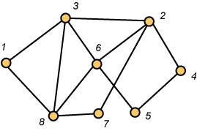
Euler Circuits in Graphs
Here is an euler circuit for this graph:
(1,8,3,6,8,7,2,4,5,6,2,3,1)

Slide 13
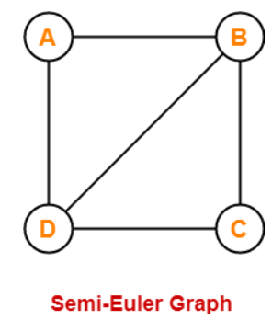
Semi Euler Graph
If a connected graph contains an Euler trail but does not contain an Euler circuit, then such a graph is called as a semi-Euler graph.
This graph contains an Euler trail BCDBAD.
But it does not contain an Euler circuit.
Euler trail: the number of vertices in the graph with odd degree
are not more than 2.
A graph will contain an Euler path if it contains
at most two vertices of odd degree.

Slide 14
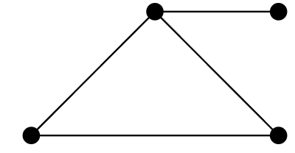
Example
A vertex with degree 1 is a dead end – unless you start there.
Even in that case, you can’t do anything without repeating the edge..
a graph has an Euler path and two vertices with odd degree, then the Euler path must start at one of the odd degree vertices and end at the other.
In such a situation, every other vertex must have an even degree since we need an equal number of edges to get to those vertices as to leave them.
But for a graph to have an Euler circuit, all vertices must have even degree.

Slide 15
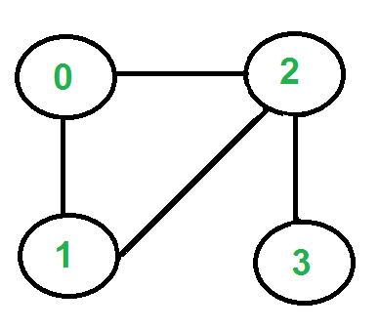
The Algorithm
Printing the Eulerian trail or cycle
The graph should have either 0 or 2 odd vertices.
If there are 0 odd vertices, start anywhere. If there are 2 odd vertices, start at one of them.
Follow edges one at a time. If you have a choice between a bridge and a non-bridge, always choose the non-bridge.
Stop when you run out of edges.

Slide 16
Euler Circuit vs. Hamiltonian Cycle
An Euler tour (circuit) of a connected, directed graph G (V, E) is a cycle that traverses each edge of G exactly once, although it is allowed to visit each vertex more than once.
Whether there is a path which visits every vertex exactly once. Such a path is called a Hamilton path (or Hamiltonian path)
We could also consider Hamilton cycles, which are Hamilton paths which start and stop at the same vertex.
Determining whether a directed graph has a hamiltonian cycle is NP-complete (will discuss this later).
However, we can determine whether a graph has an Euler circuit in only O(E) time, in fact, we can find the edges of the circuit in O(E) time.

Slide 17
MINIMUM SPANNING TREE

Slide 18
Problem: Laying Telephone Wire
Central office

Slide 19
Wiring: Naïve Approach
Central office
Expensive!

Slide 20
Wiring: Better Approach
Central office
Minimize the total length of wire connecting the customers

Slide 21
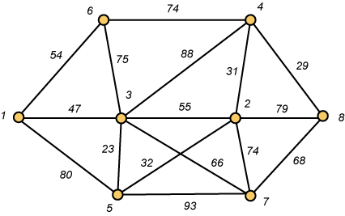
A Networking Problem
Problem: The vertices represent 8 regional data centers which need to be connected with high-speed data lines. Feasibility studies show that the links illustrated above are possible, and the cost in millions of dollars is shown next to the link. Which links should be constructed to enable full communication (with relays allowed) and keep the total cost minimal.

Slide 22
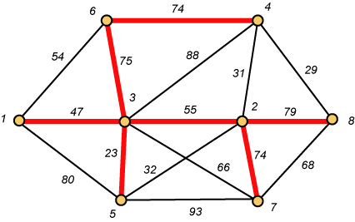
Links Will Form a Spanning Tree
Cost (T) = 47 + 23 + 75 + 74 + 55 + 74 + 79
= 427

Slide 23
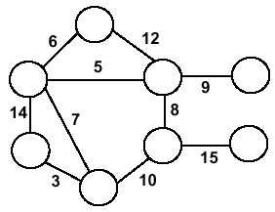
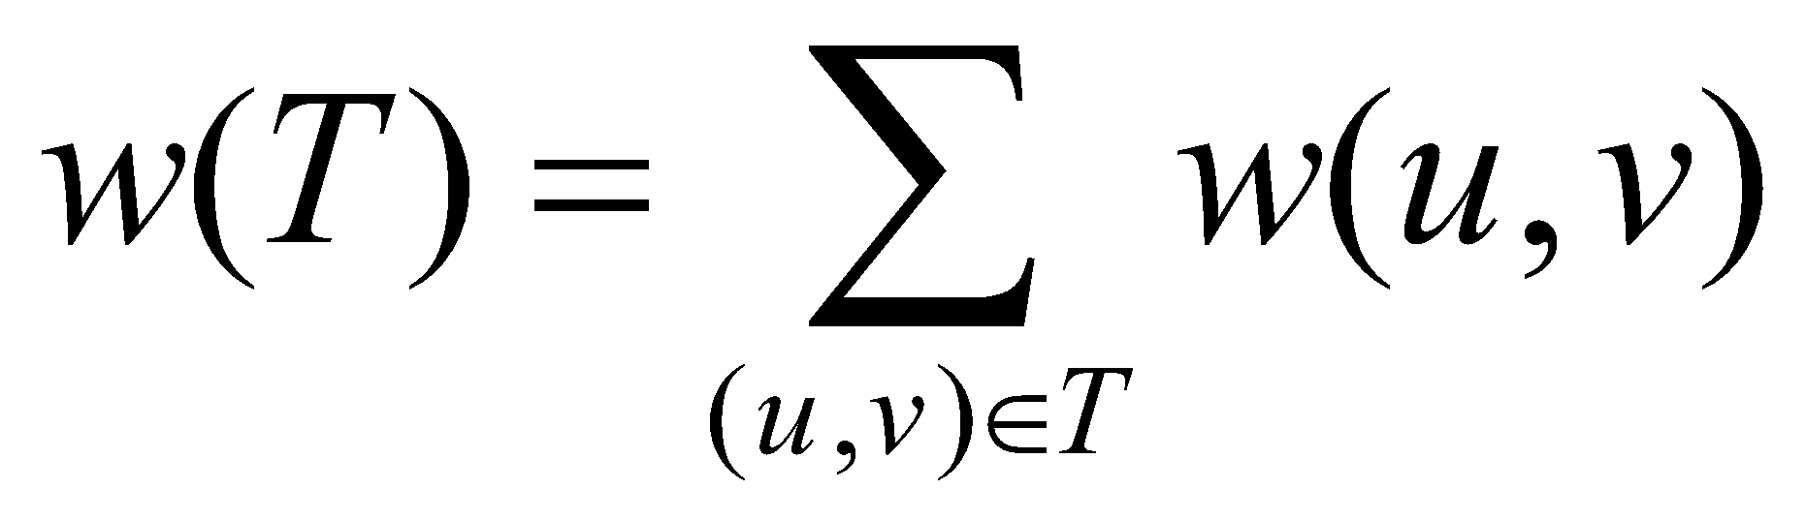
Minimum Spanning Trees
Undirected, connected graph G = (V,E)
Weight function W: E → R (assigning cost or length or other values to edges)
Spanning tree: tree that connects all the vertices (above?)
Minimum spanning tree: tree that connects all the vertices and minimizes

Slide 24
Minimum Spanning Tree (MST)
A minimum spanning tree is a subgraph of an undirected weighted graph G, such that
it is a tree (i.e., it is acyclic)
it covers all the vertices V
contains |V| - 1 edges
the total cost associated with tree edges is the minimum among all possible spanning trees
not necessarily unique

Slide 25
How Can We Generate a MST?
9
b
9
b
a
2
6
a
2
6
d
d
4
5
4
5
5
4
5
4
5
e
5
e
c
c

Slide 26
Greedy Choice
We will show two ways to build a minimum spanning tree.
A MST can be grown from the current spanning tree by adding the nearest vertex and the edge connecting the nearest vertex to the MST. (Prim's algorithm)
A MST can be grown from a forest of spanning trees by adding the smallest edge connecting two spanning trees. (Kruskal's algorithm)

Slide 27
Kruskal's Algorithm
Edge based algorithm
Add the edges one at a time, in increasing weight order
The algorithm maintains A – a forest of trees. An edge is accepted it if connects vertices of distinct trees
We need a data structure that maintains a partition, i.e.,a collection of disjoint sets
MakeSet(S,x) – simply creates a tree with just one node.
Union(S_{i},S_{j}) – causes a root of a one tree to point to the root of the other.
FindSet(S, x) – follows the parent’s pointers until it reaches the root of the tree, and nodes visited in this simple path toward the root constitute a find path.

Slide 28
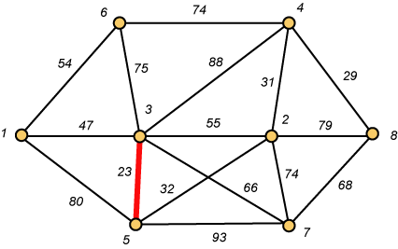
Kruskal – Step 1

Slide 29
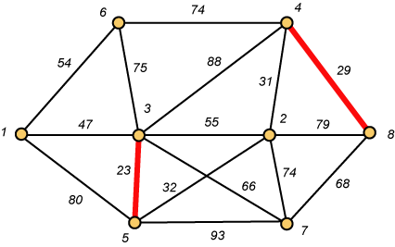
Kruskal – Step 2

Slide 30
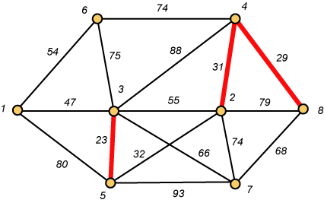
Kruskal – Step 3

Slide 31
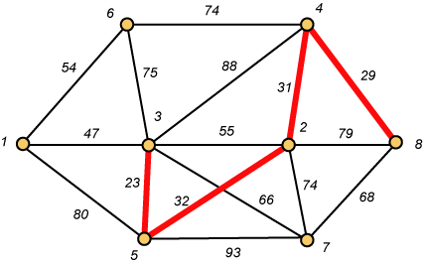
Kruskal – Step 4

Slide 32
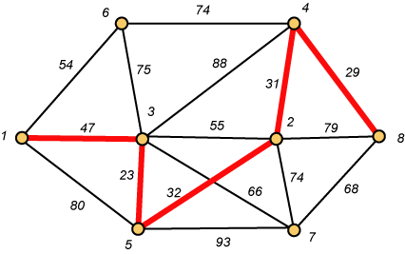
Kruskal – Step 5

Slide 33
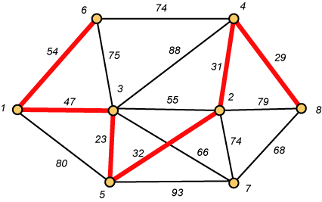
Kruskal – Step 6

Slide 34
Why Avoiding Cycles Matters
Up to this point, we have simply taken the edges in order of their weight. But now we will have to reject an edge since it forms a cycle when added to those already chosen.

Slide 35
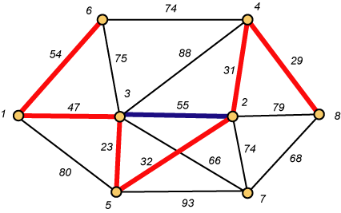
Forms a Cycle
So we cannot take the blue edge having weight 55.

Slide 36
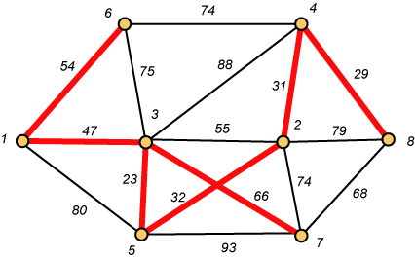
Kruskal – Step 7 DONE!!
Weight (T) = 23 + 29 + 31 + 32 + 47 + 54 + 66 = 282

Slide 37
Disjoint-Set
Keep a collection of sets S₁, S₂, .., S_{k},
Each S_{i} is a set, e,g, S₁={v₁, v₂, v₈}.
Three operations
Make-Set(x)-creates a new set whose only member is x.
Union(x, y) –unites the sets that contain x and y, say, S_{x} and S_{y}, into a new set that is the union of the two sets.
Find-Set(x)-returns a pointer to the representative of the set containing x.

Slide 38
Kruskal's Algorithm
The algorithm adds the cheapest edge that connects two trees of the forest
MST-Kruskal(G,w)
01 A ← ∅
02 for each vertex v ∈ V[G] do
03 Make-Set(v)
04 sort the edges of E by non-decreasing weight w
05 for each edge (u,v) ∈ E, in order by non-decreasing weight do
06 if Find-Set(u) ≠ Find-Set(v) then
07 A ← A ∪ {(u,v)}
08 Union(u,v)
09 return A
O(V)
O(ElogE)
O(E)
O(V)
Overall Complexity: O(VE)

Slide 39
Notation
Tree-vertices: in the tree constructed so far
Non-tree vertices: rest of vertices
Prim’s Selection rule
Select the minimum weight edge between a tree-node and a non-tree node and add to the tree

Slide 40
The Prim algorithm Main Idea
Select a vertex to be a tree-node
while (there are non-tree vertices) {
if there is no edge connecting a tree node with a non-tree node
return “no spanning tree”
select an edge of minimum weight between a tree node and a non-tree node
add the selected edge and its new vertex to the tree
}
return tree
6
a
4
b
5
u
14
2
10
c
v
3
8
15
d
f

Slide 41
Prim’s Algorithm
Vertex based algorithm
Grows one tree T, one vertex at a time

Slide 42
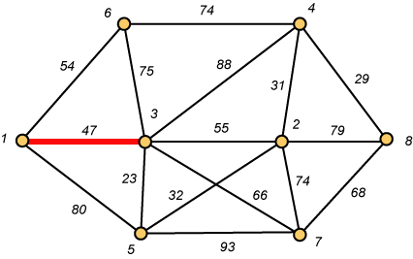
Prim – Step 1

Slide 43
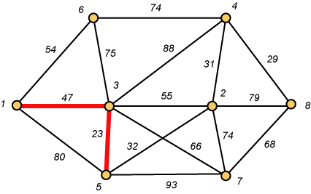
Prim – Step 2

Slide 44
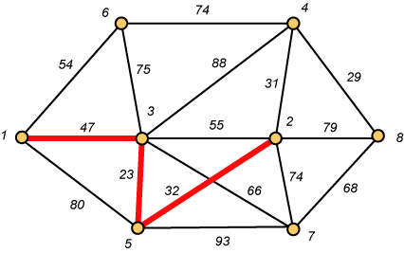
Prim – Step 3

Slide 45
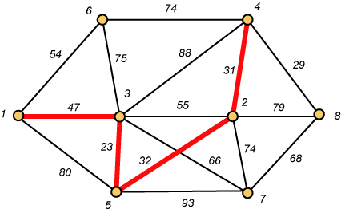
Prim – Step 4

Slide 46

Prim – Step 5

Slide 47
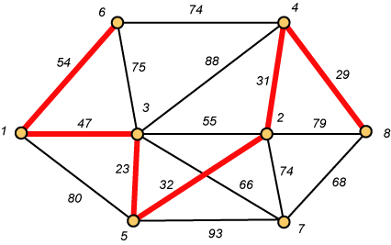
Prim – Step 6

Slide 48
Prim – Step 7 Done!!
Weight (T) = 23 + 29 + 31 + 32 + 47 + 54 + 66 = 282

Slide 49
Prim Algorithm:Variables
r:
Grow the minimum spanning tree from the root vertex “r”.
Q:
is a priority queue, holding all vertices that are not in the tree now.
key[v]:
is the minimum weight of any edge connecting v to a vertex already in the tree.
π [v]:
names the parent of v in the tree.
T[v] –
Vertex v is already included in MST if T[v]==1, otherwise, it is not included yet.

Slide 50
Prim Algorithm (2)
MST-Prim(G,w,r)
for each u ∈ Q
key[u] ← ∞
key[r] ← 0 // r is the first tree node, let r=1
π[r] ← NIL
Q.insert((key[r], r))
while Q ≠ ∅ do
u ← Q.ExtractMin()
make u part of T
for each v ∈ Adj[u] do
if v ∈ T and w(u,v) < key[v] then
π[v] ← u
key[v] ← w(u,v)
Q.insert((key[v], v));

Slide 51
The execution of Prim's algorithm(moderate part)
8
7
the root vertex
b
c
d
9
4
2
a
11
i
14
e
4
7
6
8
10
h
g
f
1
2
V | a | b | c | d | e | f | g | h | i
T | 1 | 0 | 0 | 0 | 0 | 0 | 0 | 0 | 0
Key | 0 | - | - | - | - | - | - | - | -
π | -1 | - | - | - | - | - | - | - | -

Slide 52
The execution of Prim's algorithm(moderate part)
8
7
the root vertex
b
c
d
9
4
2
a
11
i
14
e
4
7
6
8
10
h
g
f
1
2
V | a | b | c | d | e | f | g | h | i
T | 1 | 0 | 0 | 0 | 0 | 0 | 0 | 0 | 0
Key | 0 | 4 | - | - | - | - | - | 8 | -
π | -1 | a | - | - | - | - | - | a | -
‹#›

Slide 53
The execution of Prim's algorithm(moderate part)
8
7
the root vertex
b
c
d
9
4
2
a
11
i
14
e
4
7
6
8
10
h
g
f
1
2
Important: Update Key[v] only if T[v]==0
V | a | b | c | d | e | f | g | h | i
T | 1 | 1 | 0 | 0 | 0 | 0 | 0 | 0 | 0
Key | 0 | 4 | 8 | - | - | - | - | 8 | -
π | -1 | a | b | - | - | - | - | a | -
‹#›

Slide 54
The execution of Prim's algorithm(moderate part)
8
7
the root vertex
b
c
d
9
4
2
a
11
i
14
e
4
7
6
8
10
h
g
f
1
2
V | a | b | c | d | e | f | g | h | i
T | 1 | 1 | 1 | 0 | 0 | 0 | 0 | 0 | 0
Key | 0 | 4 | 8 | 7 | - | 4 | - | 8 | 2
π | -1 | a | b | c | - | c | - | a | c
‹#›

Slide 55
The execution of Prim's algorithm(moderate part)
8
7
the root vertex
b
c
d
9
4
2
a
11
i
14
e
4
7
6
8
10
h
g
f
1
2
V | a | b | c | d | e | f | g | h | i
T | 1 | 1 | 1 | 0 | 0 | 0 | 0 | 0 | 1
Key | 0 | 4 | 8 | 7 | - | 4 | 6 | 7 | 2
π | -1 | a | b | c | - | c | i | i | c
‹#›

Slide 56
The execution of Prim's algorithm(moderate part)
8
7
the root vertex
b
c
d
9
4
2
a
11
i
14
e
4
7
6
8
10
h
g
f
1
2
V | a | b | c | d | e | f | g | h | i
T | 1 | 1 | 1 | 0 | 0 | 1 | 0 | 0 | 1
Key | 0 | 4 | 8 | 7 | 10 | 4 | 2 | 7 | 2
π | -1 | a | b | c | f | c | f | i | c
‹#›

Slide 57
The execution of Prim's algorithm(moderate part)
8
7
the root vertex
b
c
d
9
4
2
a
11
i
14
e
4
7
6
8
10
h
g
f
1
2
V | a | b | c | d | e | f | g | h | i
T | 1 | 1 | 1 | 0 | 0 | 1 | 1 | 0 | 1
Key | 0 | 4 | 8 | 7 | 10 | 4 | 2 | 1 | 2
π | -1 | a | b | c | f | c | f | g | c
‹#›

Slide 58
The execution of Prim's algorithm(moderate part)
8
7
the root vertex
b
c
d
9
4
2
a
11
i
14
e
4
7
6
8
10
h
g
f
1
2
V | a | b | c | d | e | f | g | h | i
T | 1 | 1 | 1 | 0 | 0 | 1 | 1 | 1 | 1
Key | 0 | 4 | 8 | 7 | 10 | 4 | 2 | 1 | 2
π | -1 | a | b | c | f | c | f | g | c
‹#›

Slide 59
The execution of Prim's algorithm(moderate part)
8
7
the root vertex
b
c
d
9
4
2
a
11
i
14
e
4
7
6
8
10
h
g
f
1
2
V | a | b | c | d | e | f | g | h | i
T | 1 | 1 | 1 | 1 | 0 | 1 | 1 | 1 | 1
Key | 0 | 4 | 8 | 7 | 9 | 4 | 2 | 1 | 2
π | -1 | a | b | c | d | c | f | g | c
‹#›

Slide 60
Prim Algorithm (2)
MST-Prim(G,w,r)
for each u ∈ Q
key[u] ← ∞
key[r] ← 0 // r is the first tree node, let r=1
π[r] ← NIL
Q.insert((key[r], r))
while Q ≠ ∅ do
u ← Q.ExtractMin()
make u part of T
for each v ∈ Adj[u] do
if v ∈ T and w(u,v) < key[v] then
π[v] ← u
key[v] ← w(u,v)
Q.insert((key[v], v));
O(V)
Heap: O(lgV)
O(V)
Heap: O(lgV)
Overall: O(E)
Heap: O(lgV)
Overall complexity: O(V)+O(V lg V+E lg V) = O(E lg V)

Slide 61
The execution of Prim's algorithm(moderate part)
8
7
the root vertex
b
c
d
9
4
2
a
11
i
14
e
4
7
6
8
10
h
g
f
1
2
V | a | b | c | d | e | f | g | h | i
T | 1 | 1 | 1 | 1 | 1 | 1 | 1 | 1 | 1
Key | 0 | 4 | 8 | 7 | 9 | 4 | 2 | 1 | 2
π | -1 | a | b | c | d | c | f | g | c
‹#›

Slide 62
Overall Complexity Analysis - Prims
O(n²)
When we don’t use heap
To find the minimum element, we traverse the “KEY” array from beginning to end
We use adjacency matrix to update KEY.
O(ElogV)
When min-heap is used to find the minimum element from “KEY”.
O(E+VlogV)
When fibonacci heap is used to find the minimum element from “KEY”.

Slide 63
Question
Exercise
23.2.7 – Add new vertices & edges in a graph
23-1: Second best minimum spanning tree

